Slide 1
Balance Calculator - Your Expense Tracker
Team CyberWorkers
Dongsheng Cheng
Zhiqing Su
Xinyue Zhang
Zongyao Li

Slide 2
Project Description
Our project is a balance calculator that allows users to track their income and expenses. Users can view their income and expense details, total value, and current balance. They can also add or delete an income or expense record. Each detail includes information such as date, category, description, and more, providing users with a comprehensive overview of their finances.
In addition to the financial tracking features, our project includes a dashboard that displays daily news and weather updates for user convenience. Furthermore, we have incorporated a pie chart visualization of expenses to help users easily identify areas where they may be overspending.

Slide 3
Tasks Assignment
Dongsheng Cheng: Project Main Structure and Interface, API Design and Implementation, API Testing, Style Adjustment
Xinyue Zhang: API Design and Implementation, API Testing, Style Adjustment, Open Weather Map API, Visualization of expense
Zhiqing Su: API Design and Implementation, API Testing, Style Adjustment, Google Map API
Zongyao Li: API Design and Implementation, Style Adjustment, News API, API Testing

Slide 4





Tech Stack

Slide 5






API’s Implement
Frontend
Axios - request data
Open Weather Map - weather
D3 - data visualization
Exchange Rate - currency conversion
News - today’s news
Google Map - location
Backend
Mongoose - MongoDB

Slide 6
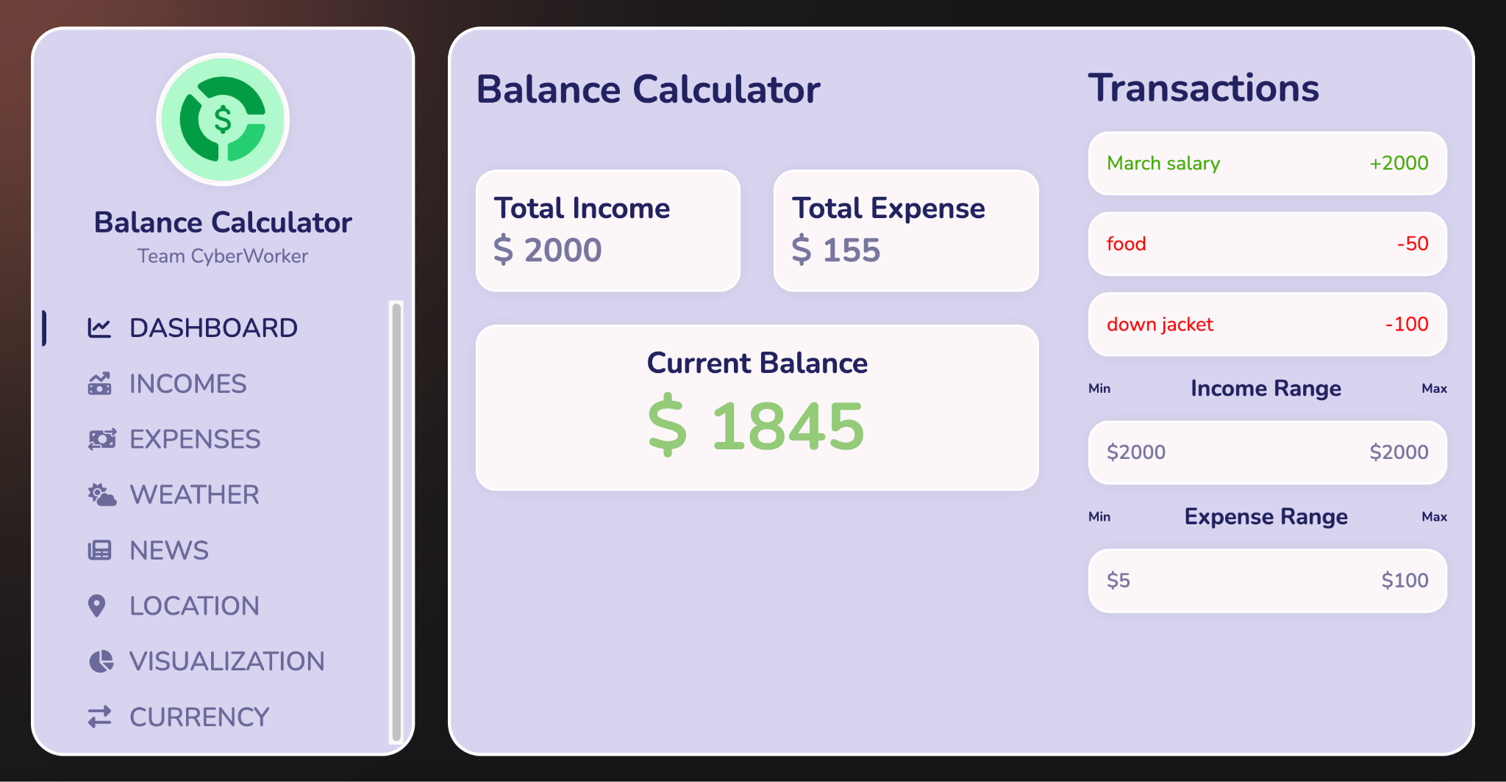
DASHBOARD
Features:
View total income/expense.
View current balance.
View 3 latest transactions.
View income/expense range.

Slide 7
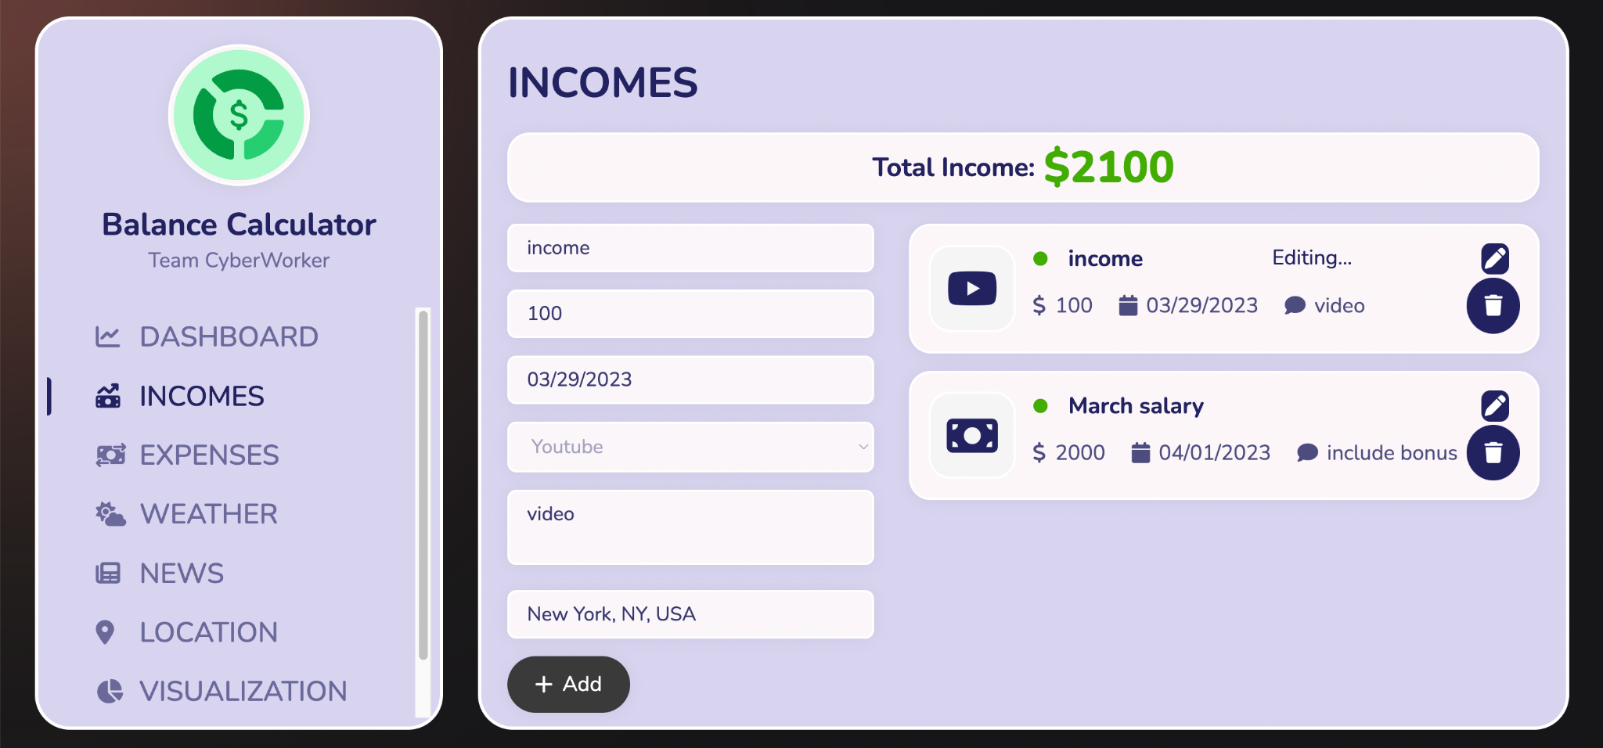
INCOMES
Features:
Add income record.
View incomes.
Delete income record.
Edit income record.

Slide 8
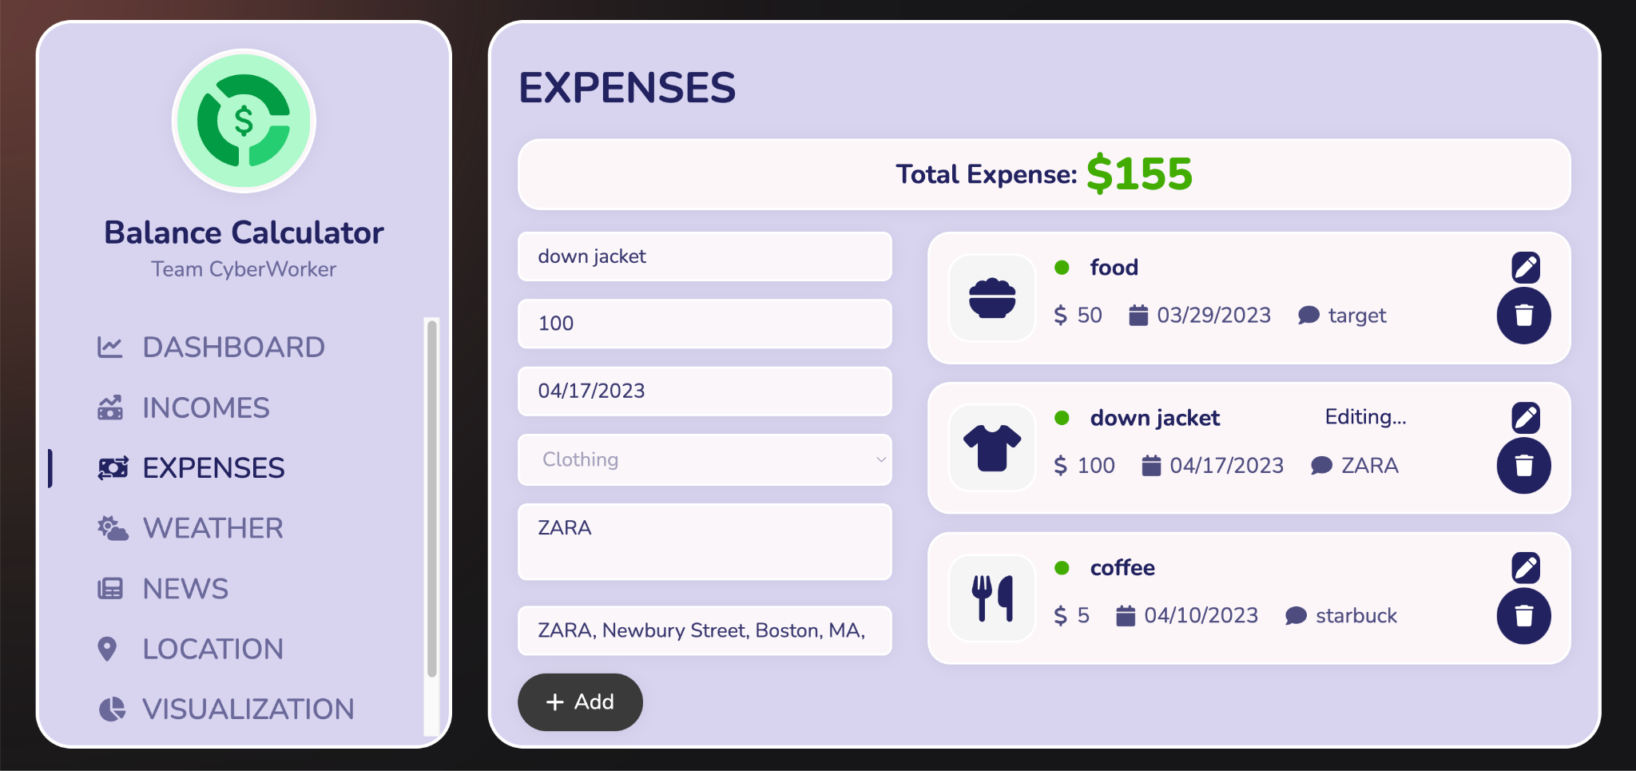
EXPENSES
Features:
Add expense record.
View expenses.
Delete expense record.
Edit expense record.

Slide 9
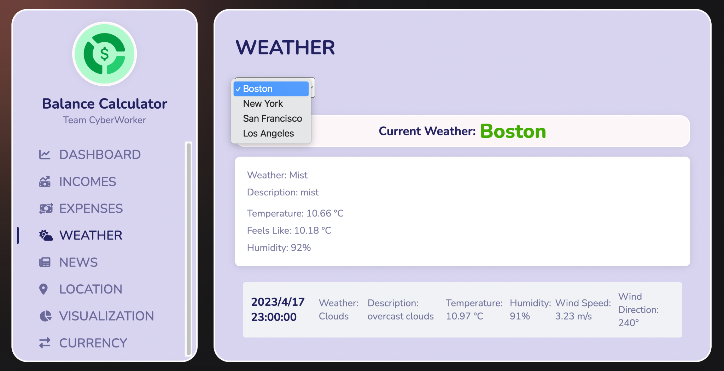
WEATHER - Open Weather Map Api
Features:
Choose desired city.
View current weather details.

Slide 10
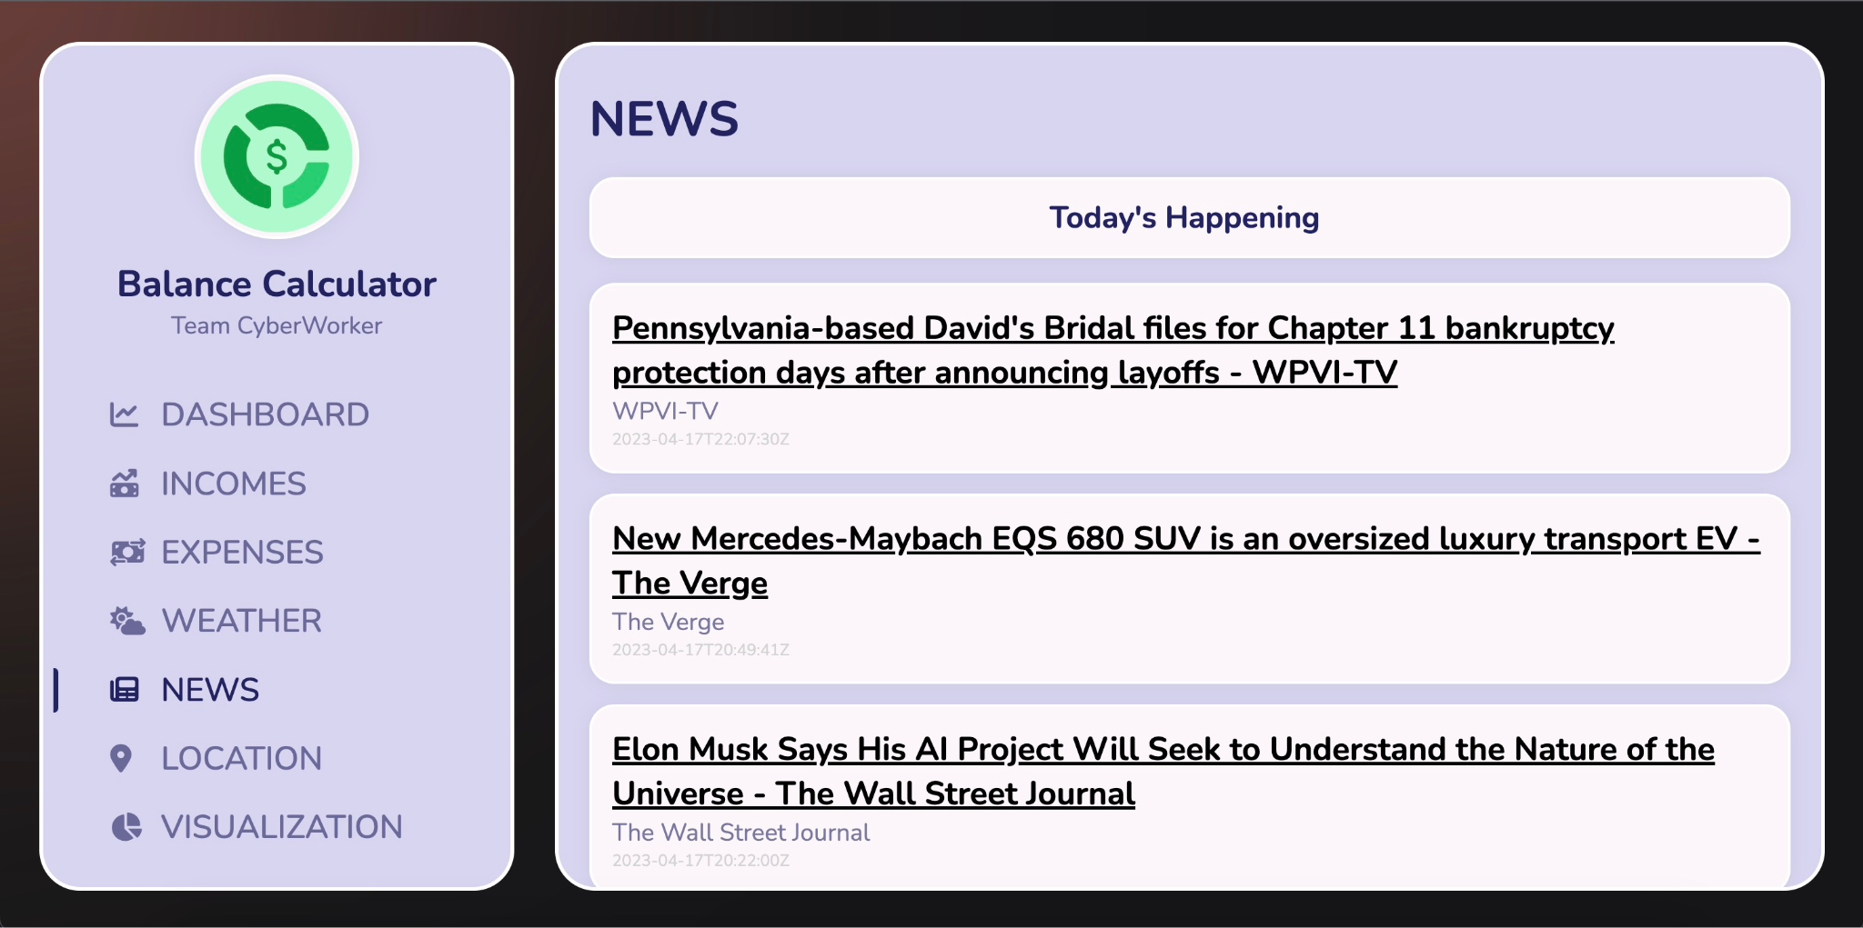
NEWS - News Api
Features:
Fetch the latest 5 News in Business category, listing the title, source, and publish time

Slide 11
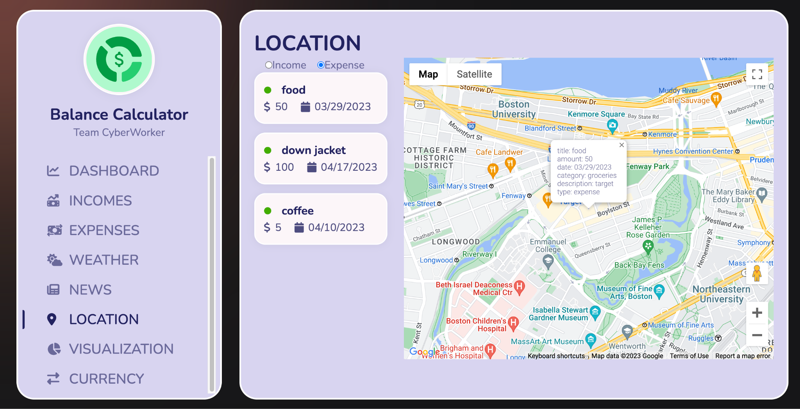
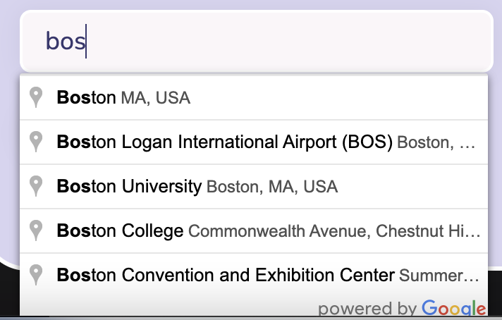
LOCATION - Google Map Api

Slide 12
LOCATION - Google Map Api
Dependencies:
@react-google-maps/api
react-geocode
Features:
Search and autocomplete address when adding a new transaction.
Show Google Map in location dashboard.
Mark the address where the selected transaction is located when the transaction in the list is clicked.
Show transaction details when marker is clicked.

Slide 13
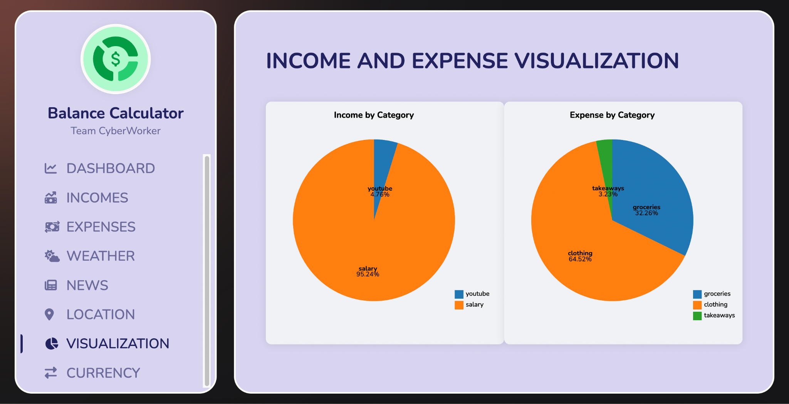
INCOME AND EXPENSE VISUALIZATION - D3.js Library
Features:
View the proportion of each category of income and expense.

Slide 14
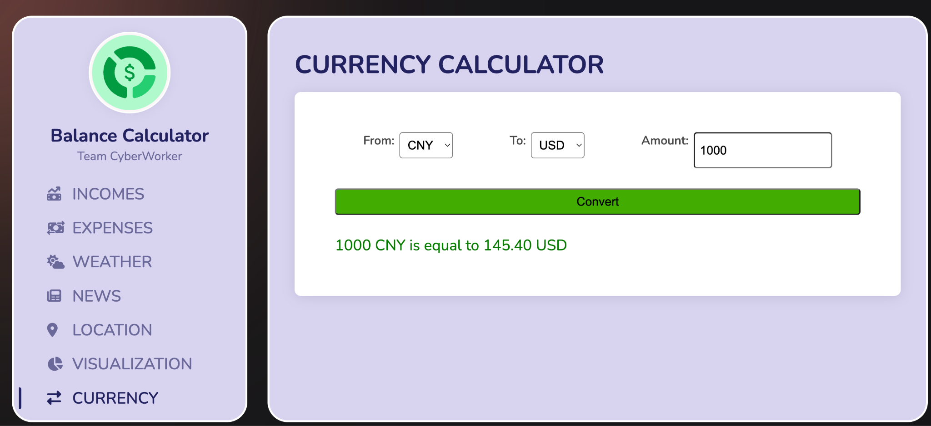
CURRENCY - Exchange Rate Api
Features:
Select existing currency and target currency for exchange rate conversion.

